Slide 1
Flow Cytometry presentrd by Dr Niloofar Neisi associated professor in medical virology

Slide 2
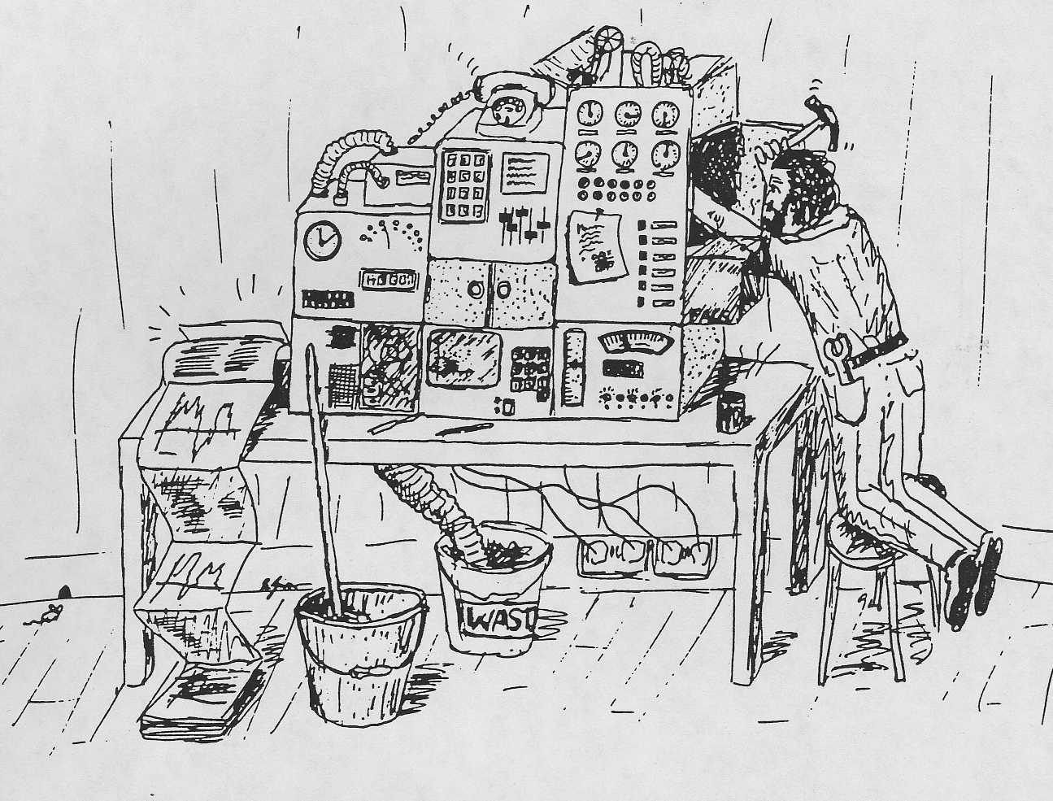
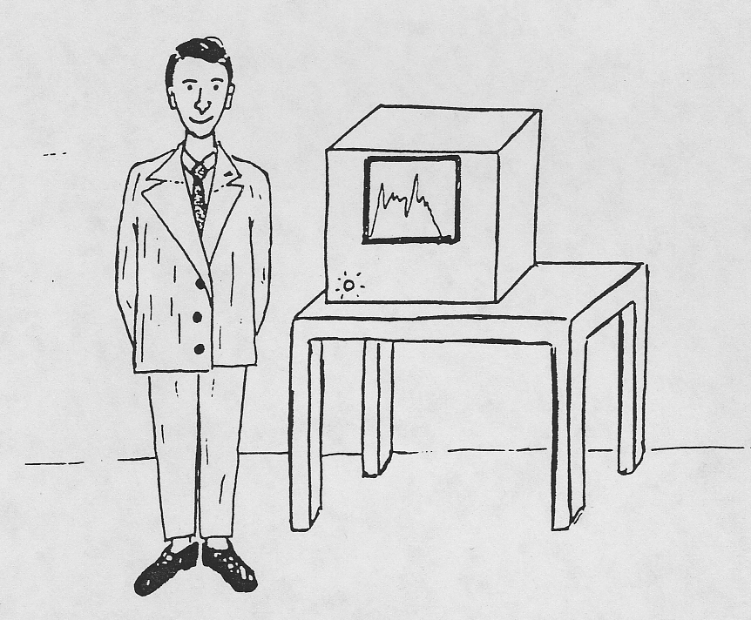
Two Views of Flow Cytometry

Slide 3
Historical Highlights
Flow cytometry was initially conceived as a practical methodology to count blood cells.
In 1879 Lord Rayleigh observed that fluid emerging from an orifice breaks into a series of droplets. Cell sorting is based on the physics of droplet formation.
In 1934, A. Moldavan reported the development of the first device that could count red blood cells automatically while in flow. (Science. 1934 Aug 24;80(2069):188-9 PHOTO-ELECTRIC TECHNIQUE FOR THE COUNTING OF MICROSCOPICAL CELLS)
In 1949, Wallace Coulter filed a patent entitled, “Means for Counting Particles Suspended in a Fluid”. The patent was issued in 1953. This lead to the development of the “Model A” Coulter Counter. Today, clinical hematology laboratory instruments used to count blood cells employ the principles developed by Coulter.

Slide 4
In 1965, Mack J. Fulwyler reported the first flow cytometry instrument capable of sorting cells. He sorted cells based on their Coulter volume by using a Coulter cell sizing instrument and modifying the electrostatic ink jet droplet deflection technique developed by Richard G. Sweet. (Rev. Sci. Instrum. 36, 131 (1965); http://dx.doi.org/10.1063/1.1719502 High Frequency Recording with Electrostatically Deflected Ink Jets)
In 1968 Wolfgang Göhde designed a fluorescence based flow cytometer (ICPII) in 1968 which was commercialized by Partec in 1969. In 2000 he turned his efforts toward developing a program to provide low cost CD4 tests for people with AIDS in Africa.
Lou Kamentsky and Myron Melamed worked on distinguishing cancer cells from normal cells using differences in the absorption and scattering of light. Kamentsky designed the Rapid Cell Spectrophotometer (RCS), which measured nucleic acid content and cell size.
Leonard Herzenberg, an immunologist at Stanford, used the RCS prototype realizing how useful this technology would be in cell biology, He coined the term ‘FACS’ – Fluorescence Activated Cell Sorter. Becton Dickinson (BD) owns the FACS trade name and launched the first commercial instrument, FACS-1 in the early 1970’s.
Today, flow cytometers with 5 lasers capable of analyzing or sorting cells labeled with 18 fluorochromes is possible. Soon instruments capable of 50 parameters may be possible.

Slide 5
Flow cytometry is a widely used method for
Analyzing the expression of cell surface and intracellular molecules
Characterizing and defining different cell types in a heterogeneous cell population
Assessing the purity of isolated subpopulations and analyzing cell size and volume
It allows simultaneous multi-parameter analysis of single cells.

Slide 6
Flow Cytometry Is A Powerful Technique For Characterizing Immune Cells
Allows For Detection Of Surface Markers Of Cells
Allows For Detection Of Intracellular Factors
Allows Detection Of Secreted Factors By Cells
Allows For Detection Of DNA Content

Slide 7
Sample Preparation
  Samples must be in single cell suspension
  Solid tissue requires mechanical dissociation and often enzymatic digestion
  Adherent cell lines require detachment from the culture dish and dissociation
  Cell aggregates must be filtered out
  Red cells should be lysed
  Well prepared single cell suspensions yield good data

Slide 8
The staining procedure:
making a single-cell suspension from cell culture or tissue samples
The cells incubated in tubes or microtiter plates with unlabeled or fluorochrome-labeled antibodies and analyzed on the flow cytometer.

Slide 9
Fluorescent Markers
Flow cytometry derives its strength and versatility through fluorescence detection.
Cells can be labeled internally or on their cell surface with specific fluorescent molecules.
The specificity of these markers then allows the cells to be identified or sorted for further study.
Measure fluorescence intensity produced by fluorescent-labeled antibodies
detecting proteins.

Slide 10
ligands that bind to specific cell-associated molecules such as propidium iodide binding to DNA.
DNA probes provide DNA content for cell cycle determinations.
Monoclonal antibodies are homogeneous populations of antibody molecules which are identical and specific for a given receptor.
Fluorescent labeled monoclonal antibodies are often used to identify populations of cells.
The physiological properties of living cells can also be analyzed using a number of specific probes.

Slide 11
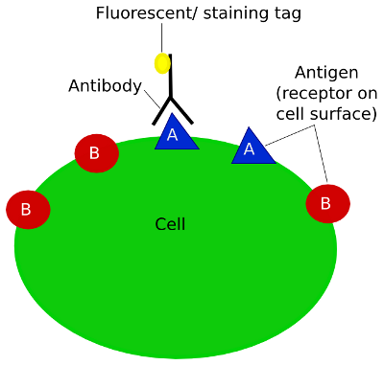
Antibody Staining Factors
Know instrument configuration
  What lasers and detectors are available
  Select monoclonal antibodies specific for cells of interest (CD stands for Cluster of Differentiation)
  CD20 for B Lymphocytes
  CD3 for T Lymphocytes
Identify antigen density of membrane and intracellular epitopes
  Reference charts are available to show molecules of antigen per cell
  Density may differ due to activation level and functional differences
Select fluorochromes based on antigen density
  Low epitope density use bright fluorochrome like PE (Phycoerythrin) or New Brilliant Violet 421 which is 3-4 times brighter than PE
  High epitope density use dim fluorochrome like FITC (fluorescein)
Titrate antibodies for optimal signal

Slide 12
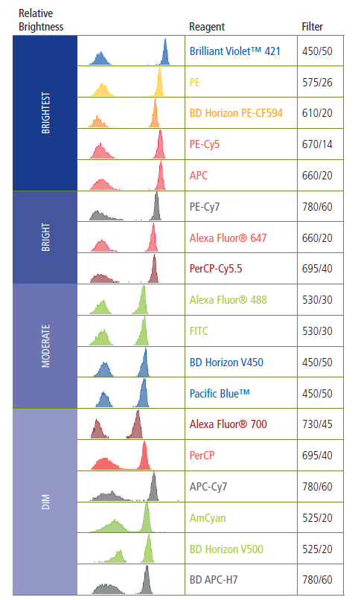
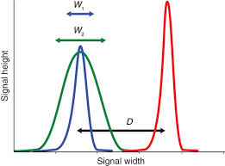
Stain Index
Stain Index (SI) = D/W
  D = difference between positive and negative peak medians
  W = the spread of the background peak (= 2X rSD_{negative})
  Resolution sensitivity is the ability to resolve a dim positive signal from background

Slide 13
Three Major Components
Fluidics: Transports the cells to the laser interrogation point
Optics: Collects light signal generated by scatter and fluorescence emission
Electronics: Converts optical signals into digital signals that can be processed by a computer

Slide 14
Fluidics
A normal physiological saline liquid, known as sheath fluid, is used to move the cells through the flow cell, to the sensing area.
The sensing area is the point at which the cells are interrogated by the laser beam. The cells or particles to be analyzed are suspended in a sample fluid.
The sheath fluid has a higher flow rate than the sample fluid. This difference serves to constrict the sample stream to the center of the flow cell.

Slide 15
This method, known as hydrodynamic focusing, aligns the cells in a single file in the center of the stream and laminar flow allows these two fluids to move in the same direction through a flow cell without mixing.
This design insures that the cells in the sample are contained in a central core surrounded by sheath fluid and are illuminated optimally by the light source.
When a cell suspension is run through the cytometer, sheath fluid is used to hydrodynamically focus the cell suspension through a small nozzle. The tiny stream of fluid takes the cells past the laser light one cell at a time

Slide 16
Light scattered from the cells or particles is detected as they go through the laser beam.
A detector in front of the light beam measures forward scatter (FS)
several detectors to the side measure side scatter (SS).
Fluorescence detectors measure the fluorescence emitted from positively stained cells or particles.

Slide 17
Basic Flow Cell
Sample: Inner Stream containing a mixed population of cells
Sheath Fluid: Outer Stream
Forward Scatter Detector
Sensing Area
Lasers
Side Scatter Detector and Fluorescent Detectors

Slide 18
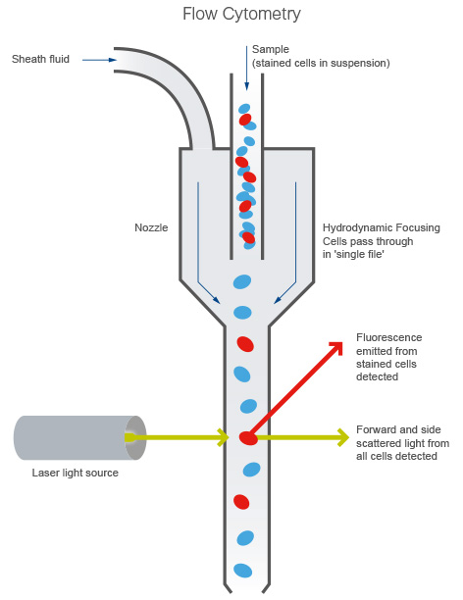

Slide 19
Light Scatter Parameters
Forward Scatter (FCS) is an indicator of cell size, shape and refractive index which is related to cell membrane integrity
Side Scatter (SSC) is an indicator of cellular granularity or cellular inclusions
A three part differential is possible by viewing FSC vs. SSC in peripheral blood

Slide 20
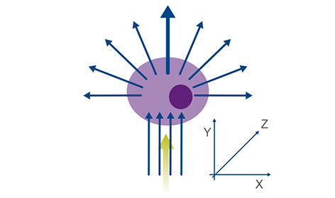
Light scatter as the green laser interrogates the cell.
The direction of light scattered by the cell correlates to cell size and granularity.

Slide 22
Example of this is blood samples on the flow cytometer:
Larger and more granular granulocyte cells produce a large population with high SS and FS.
Monocytes are large cells, but not so granular, so these produce a separate population with high FS but lower SS.
Smaller lymphocytes and lymphoblasts produce a separate population with less FS. They are not granular cells, so also have low SS.
Therefore, these cells can be separated into different populations based on their FS and SS alone.

Slide 23
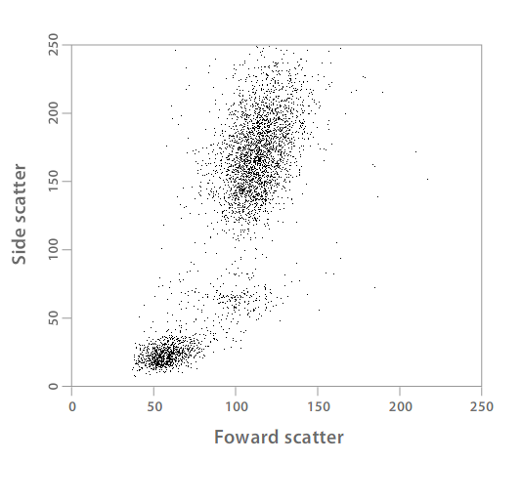
Light Scatter Parameters
Granulocytes'
Monocytes
Lymphocytes

Slide 24
Forward Scatter
FSC or FALS (Forward Angle Light Scatter)
FSC signal is relative to cell size and refractive index which is related to cell membrane integrity
Laser Excitation
Photodiode FSC Detector

Slide 25
Side Scatter
SSC or RALS (Right Angle Light Scatter)
SSC is proportional to the internal complexity of the cell. The greater the number of inclusions or granules, the higher the SSC.
Laser Excitation
SSC PMT Detector – 90 Degrees to FSC Detector

Slide 26
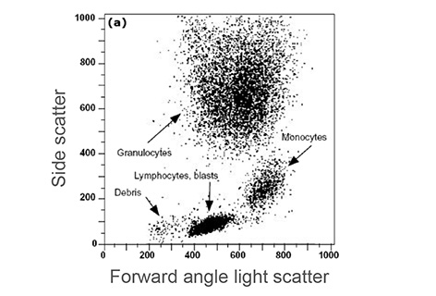
Dot plot of FS versus SS. Each dot represents a single cell analyzed by the flow cytometer. The characteristic position of different cell populations is determined by differences in cell size and granularity.

Slide 27
Threshold
Cell fragments and debris can be eliminated from the analysis by setting a threshold which will discriminate what cells should be collected.
Threshold is usually set on Forward Scatter, but can be set on any parameter

Slide 28
Sample Differential
Difference in pressure between sample and sheath fluid.
The sample pressure will always be higher than the sheath fluid pressure.
When the sample flow rate is increased, the sample core stream becomes wider.
When the differential is large, cells will no longer pass through the flow cell in a single file.
This results in high coefficient of variation (CV) and less accurate data in some cases.
Summary:
  Lower flow rates are better when optimal resolution of populations is critical, such as DNA analysis.
  Higher flow rates are acceptable for qualitative measurements such as immunophenotyping.

Slide 29
Low Sample Differential
Sample: Inner Stream containing a mixed population of cells
Sheath Fluid: Outer Stream
Sensing Area
Cells in single file results is low CV’s
(Optimal for DNA cell cycle analysis)

Slide 30
High Sample Differential
Sample: Inner Stream containing a mixed population of cells
Sheath Fluid: Outer Stream
Sensing Area
Cells no longer in single file results is high CV’s
(Acceptable for qualitative measurements such as immunophenotyping.)

Slide 31
Optics
Flow Cytometers use light beams to measure properties of cells.
Early instruments used mercury arc lamps as the light source. Today many flow cytometers have three or more lasers of different wavelengths. This provides for multiple fluorescent measurements simultaneously.
Fluorescent light emits at a longer wavelength than that of the excitation light.
The amount of light that is scattered by the cell or particle gives information relative to it’s size and internal structures.

Slide 32
The fluorescence of specific markers conjugated to fluorescent dyes is distinguished by light detectors called photomultipliers tubes.
These tubes are used to amplify the weak light signal from a fluorescent marker.
Several optical filters are precisely arranged in front of each photomultiplier tube (PMT) to direct the desired wavelength of light to the detector.
Photodiodes are commonly used for strong signals, such as forward light scatter.
Some instruments use forward light scatter PMTs for analysis of bacteria and nanoparticles.
Both detectors convert light signal into an electrical signal that can be further processed and analyzed.

Slide 33
Photomultiplier Tube (PMT)
Photomultiplier tubes are used for light detection of very weak signals in the ultraviolet, visible and near-infrared ranges.
The absorption of a photon of light in the PMT results in the emission of an electron. These detectors can multiply the current produced by as much as 100 million times.
Increased voltage can be applied to the PMT to further increase the signal

Slide 34
The flow cytometer: measurement of scattered light and fluorescence
Cells can separated by whether they express a particular protein.
In this case, a fluorochrome is used to stain the protein of interest.
Fluorochromes used for the detection of target proteins emit light when excited by a laser with the corresponding excitation wavelength.
These fluorescent stained cells or particles can be detected individually.
Forward and side scattered light and fluorescence from stained cells are split into defined wavelengths and channeled by a set of filters and mirrors within the flow cytometer.
The fluorescent light is filtered so that each sensor will detect fluorescence only at a specified wavelength. These sensors are called photomultiplying tubes (PMTs).

Slide 35
Fluorescence And Antibodies
To The Rescue

Slide 36
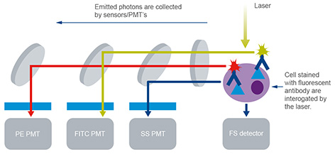
Fluorescent light is filtered so that each PMT detects a specific wavelength. The PMTs convert the energy of a photon into an electronic signal – a voltage.

Slide 37
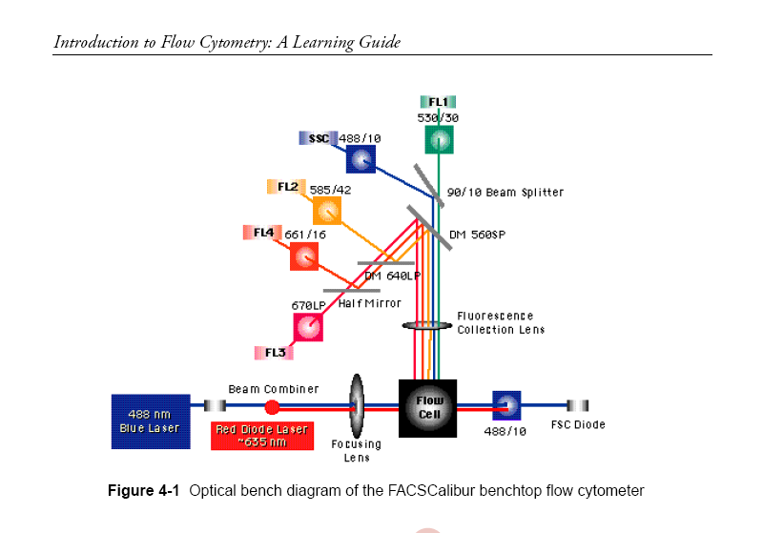
Architecture Of A FacsCalibur Instrument

Slide 38
LASERS
Light Amplification by Stimulated Emission of Radiation
The laser emits light in the form of electromagnetic radiation at a single wavelength known as monochromatic light
Lasers used for flowcytometry range from 300nm to 700nm excitation.

Slide 39
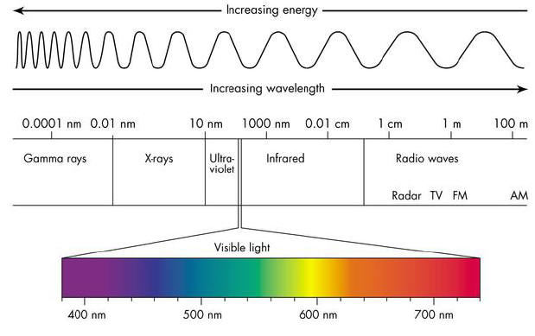
Colors
488 nm wavelength is the most commonly used type of laser in Flow Cytometers
Many 5 laser instruments have these additional lasers
  355 nm UV
  405 nm Violet
  640 nm Red
  561 nm Yellow-Green

Slide 40
Fluorescence Detection
Fluorochromes on the cell surface or inside the cell are excited by the laser beam as the cell passes the interrogation point.
These fluorochromes then release energy as they leave their excited state.
The energy release is in the form of a photon with a specific wavelength, longer than the excitation wavelength.
These photons of light are steered and collected by optical lens and filters at specific wavelengths.

Slide 41
Fluorochrome Emission
The laser beam excites the fluorochrome at a specific wavelength (absorption) and the fluorochrome emits light at a separate wavelength (emission).
• Note that absorption color differs from emission color.

Slide 42
Optical Filters
Long Pass Filter
  500LP: Wavelength 500 nm and longer will pass through filter. Wavelength shorter than 500 nm will be reflected.
Short Pass Filter
  500SP: Wavelength 500 nm or shorter will pass through filter. Wavelength greater than 500 nm will be reflected.
Band Pass Filter
  BP500/50: Wavelength 500 nm +/- 25nm will pass through (wavelength 475-525nm)

Slide 43
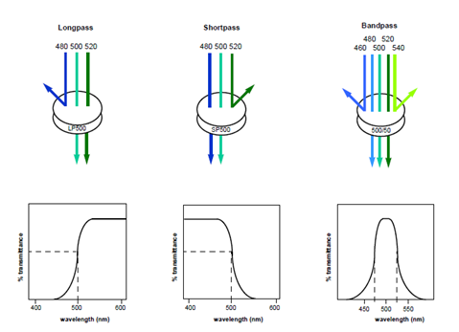
Optical Filters

Slide 44
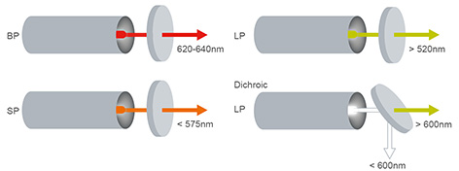
Filters in the flow cytometer. Band pass (BP) filters allow transmission of photons that have wavelengths within a narrow range. Short pass (SP) filters allow transmission of photons below a specified wavelength.
Long pass (LP) filters allow transmission of photons above a specified wavelength. Dichroic filters/mirrors (such as dichroic LP mirrors) are positioned at a 45° angle to the light beam.
Sub heading In a long pass dichroic filter, photons above a specific wavelength are transmitted straight ahead, whilst photons below the specific wavelength are reflected at a 90° angle.

Slide 45
Electronics
The Photomultiplier tubes (PMT) detectors collect photons of light and convert them to electrical signals that can be amplified using log amplifiers.
Linear amplifiers are used to amplify the forward angle and side scatter signals. These amplified electrical signals are then analyzed and recorded.
The voltages are converted into numbers which can be further analyzed. This process is known as an analog-to-digital (A-D) conversion.
The information from each cell that passed through the laser beam is now in a form that can be analyzed using various software programs designed specifically for flow cytometry data.

Slide 46
Measurement of signal
As the fluorescing cell passes through the laser beam, it creates a peak or pulse of photon emission over time.
These are detected by the PMT and converted to a voltage pulse, known as an event.
The total pulse height and area is measured by the flow cytometer.
The measured voltage pulse area will correlate directly to the intensity of fluorescence for that event.

Slide 47
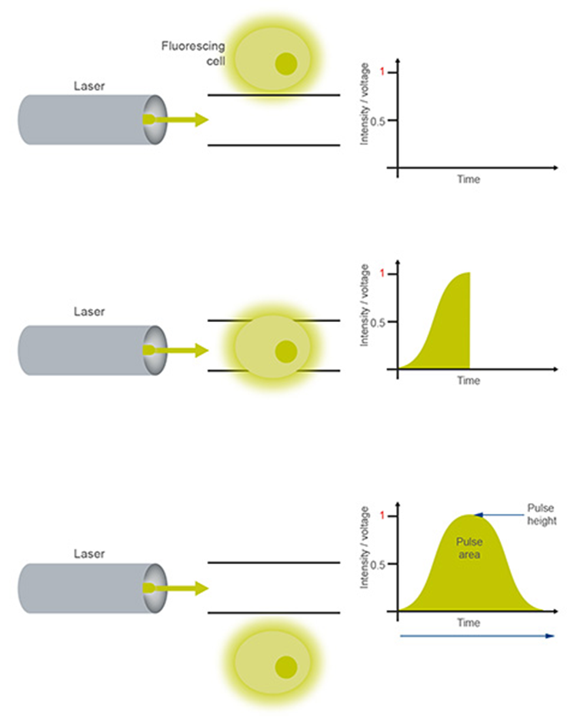
The PMT measures the pulse area of the voltage created each time a fluorescing cell releases photons. When no fluorescing cells pass through the optics, no photons are emitted and no signal is detected. As the fluorescent labeled cell passes through the optics and is interrogated by the laser, photons are emitted and so the intensity of the voltage measured increases. As each fluorescing cell completes its path through the laser beam, this leaves a pulse of voltage over time.

Slide 48
The voltage pulse height, width, and area are determined by the
particle’s size, speed, and fluorescence intensity.
• The pulse parameters are then acquired and analyzed in real-time by a computer.

Slide 49
Anatomy of a Pulse
Pulse Height
Voltage Intensity
Pulse Area
Pulse Width
Time

Slide 50
The pulse area is calculated by adding the height values for each time slice of the pulse, determined by the speed of the analog to digital converter (ADC), which is 10 MHz (i.e. 10 million per second or 10 per microsecond).
These events are assigned channels based on pulse intensity (pulse area). This signal can be amplified by turning up the voltage going through the PMT.
Each event is given a channel number depending on its measured intensity; the more intense the fluorescence, the higher the channel number the event is assigned.
For a positive result you are looking for the shift in intensity between negative control and a positive sample

Slide 51
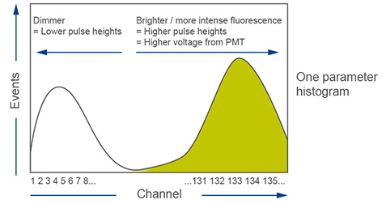
A one parameter histogram plotting channel number vs. number of events. The channels are usually viewed on a log scale on the x axis.

Slide 52
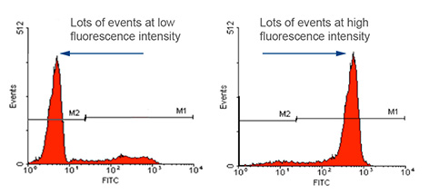
Fluorescence intensity measurements for a negative and positive result. The negative result shown on the left has no staining and many events at low fluorescence intensity. A positive result is shown on the right, this has a large number of events at high fluorescence intensity.

Slide 53
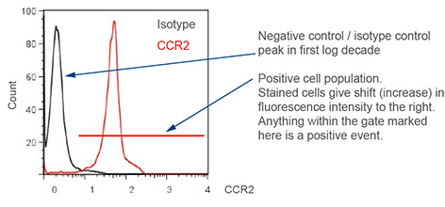
Anti-CCR2 antibody (ab21667) staining of human PBMC gated on monocytes.

Slide 54
Example Channel Layout for Laser-based Flow Cytometry
PMT
4
Dichroic
PMT
Filters
3
Flow cell
PMT
2
Bandpass
Filters
PMT
1
Laser

Slide 55
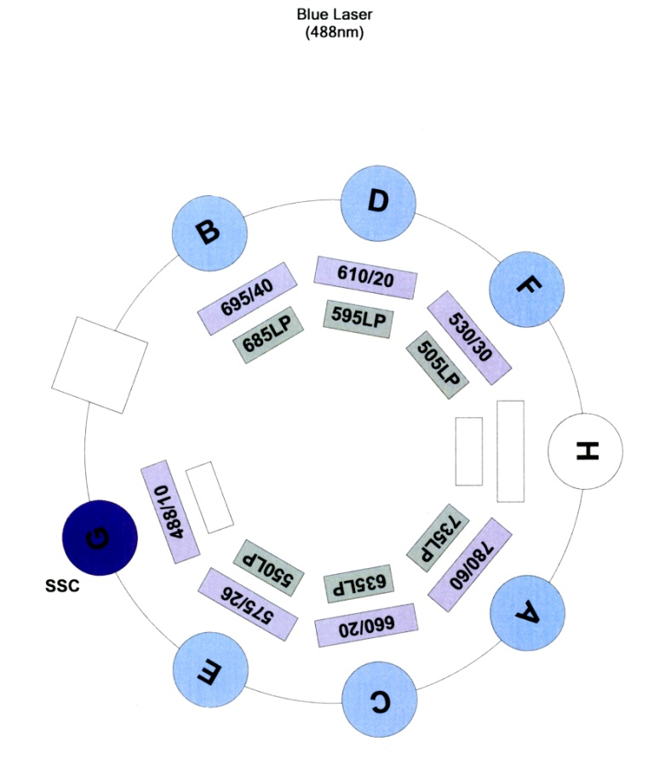
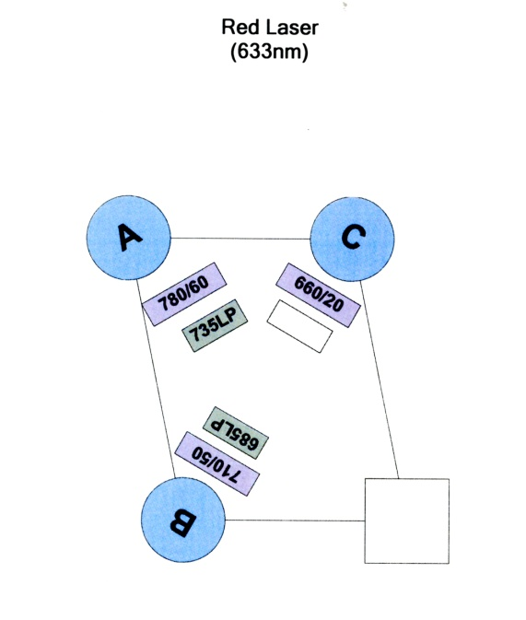
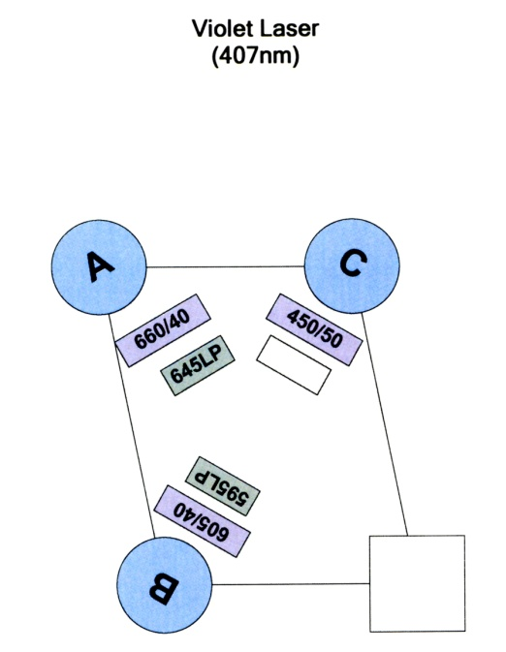
Optical Path Configuration
BD LSRII or BD FACSAria II – 12 Color

Slide 56
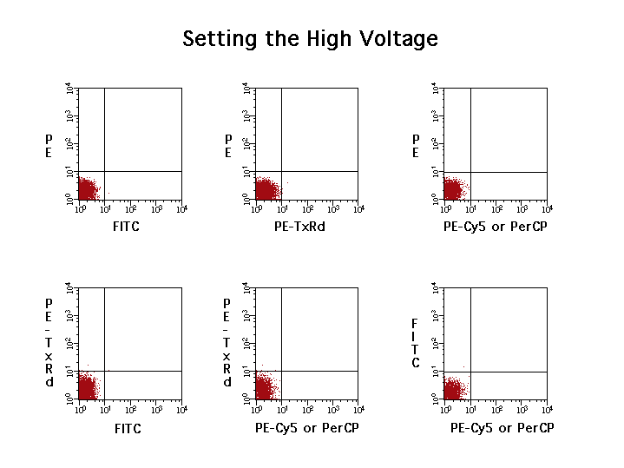
Notes:
Set PMT voltages for all fluorochromes so that cells are contained inside the 10¹ x 10¹ quadrant of each bivariate plot but make sure FL3 is 15 volts higher than FL4.

Slide 57
Compensation
Is used to electronically subtract the fluorescence emission spectral overlap that can occur between different probes.
Data that is under compensated will lead to false positives.
Data that is over compensated will lead to an under estimate of positives.

Slide 58
Immunophenotyping
Many cell surface features (as well as some internal characteristics) can be simultaneously assessed by employing different combinations of fluorochromes.
Several uniquely colored fluorochromes are available to conduct such multicolor (multiparameter) experiments.

Slide 59
Immunophenotyping
However, many fluorochromes possess overlapping emission wavelengths.

Slide 60
Compensation
• When the wavelengths of two fluorochromes overlap, the observed fluorescent signal detected by the flow cytometer may not be the actual signal displayed by the cell.
• In other words, the cell appears to possess a surface marker or phenotype that it does not actually have.

Slide 61
Compensation
• This fluorescence interference can be corrected for by adjusting the measurement parameters of the flow cytometer (either manually or automatically).
• This correction is termed compensation.
• In addition, this problem can be avoided by carefully selecting fluorochromes that do not overlap.

Slide 62
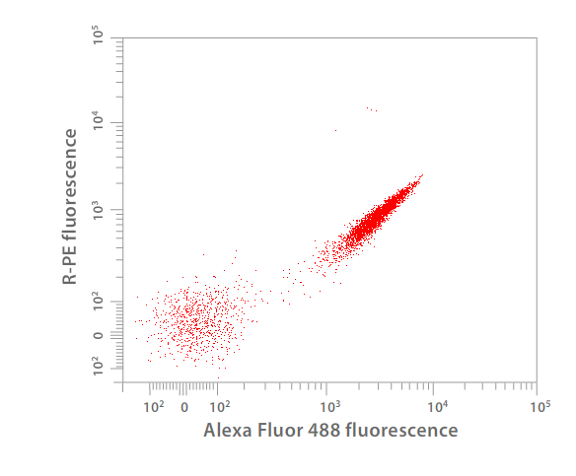
FITC Fluorescence Parameter
Not Compensated
CD8 PE
CD 4 FITC

Slide 63
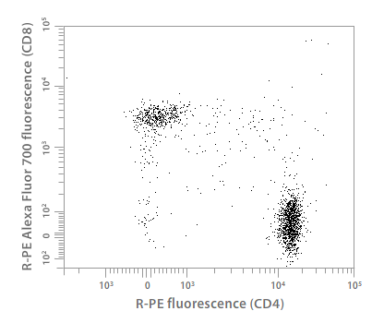
Fluorescence Parameters
Well Compensated
26%
2%
CD 8 PE
2%
70%
CD 4 FITC

Slide 64
BD Fluorescence Spectrum Viewer A Multicolor Tool
Aids in determining the amount of spectral overlap to expect with specific probes.
Enables better selection of probes.
Enables better selection of filters to use to acquire data.

Slide 65
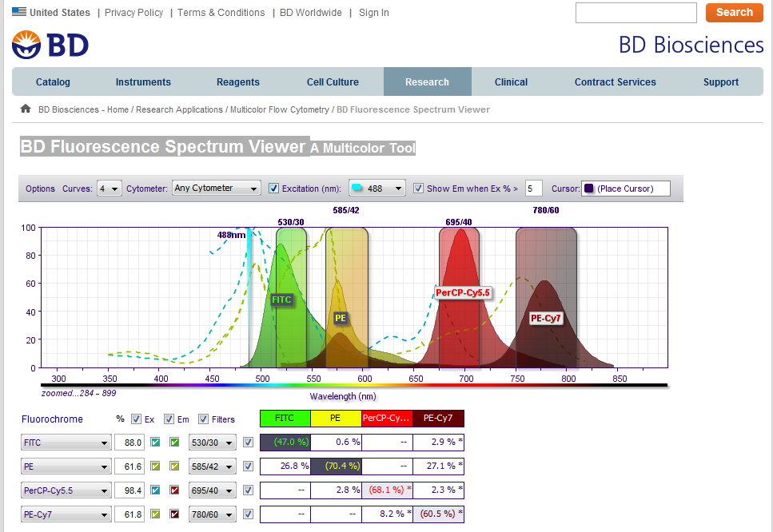
BD Fluorescence Spectrum Viewer A Multicolor Tool

Slide 66
Flow Sorting
Flow sorting selects specific cells or particles based on any number of parameters and physically isolates them.
One of the major differences between a sorter and an analyzer is the ability of the flow cell to vibrate by means of a piezoelectric crystal at a frequency 20,000 Hz or higher.
The vibration causes the stream to form droplets. Each droplet generated is of the same size.

Slide 67
Each cell is analyzed as it passes through the flow cell. If the cell meets the criteria established for sorting, a voltage is applied to the stream at the moment that a droplet is forming. The drop will then be charged and deflected by the high voltage deflection plates as it moves downward.
The voltage on the stream is reduced to zero to avoid charging unwanted drops.
Temperature controlled tubes containing media are positioned to collect the desired drops.
It is possible to sort four populations simultaneously at rates of 30,000 to 70,000 cells per second on the FACSAria cell sorter developed by BD Biosciences. The MoFlo Astrios cell sorter, developed by Beckman Coulter can sort 6 populations simultaneously at rates of 70,000 cells per second.

Slide 68
An electrostatic charge is used to deflect a drop containing a fluorescently-labeled cell into one of three collection vessels.

Slide 69


Flow Sorting
Deflection Plates (6,000 volts)

Slide 70
Sort Process
  Cell to be sorted enters the stream and is identified based on scatter and or fluorescence criteria.
  Cell triggers the lasers
  Cell moves down the stream
  Cell enters the last drop before breakoff
  Stream is charged
  Drop containing the cell of interest separates from the stream and carries a charge
  Stream is grounded
  Charged drop enters electric field and is deflected
  Cell is collected in a vessel containing a buffer

Slide 71
Data Analysis
Flow cytometry data is collected in a list mode data file.
This means that values for every parameter selected is recorded for every cell that is interrogated by the laser beam.
Flow cytometry data files can be very large containing information for millions of cells.
A powerful computer is necessary to analyze this data.

Slide 72
Gating
• To optimize the analysis of multiparameter experiments, gating is performed to isolate cell subpopulations of interest.
• This step often eliminates the need to physically sort cells for further analysis.

Slide 73
10 Color Panel Development Peripheral Blood Example
neutrophils
monocytes/macrophages
DCs
B cells
CD4s
CD8s
Basos
Eos
mast cells

Slide 74
10 Color Panel Development - Peripheral Blood Example
Large FSC/SSC gate needed to encompass all cell types
Both CD45- and CD45+ DC’s may be of interest
PMN’s
DC’s
DC’s
CD8+ T-Cells
SSC
CD 11c
CD8
Monos
Lymphs
CD4+ T-Cells
FSC
CD45
CD4
B Cells
Neutrophils
B220
GR-1
B220
Eosinophils
Monocytes/ Macrophages
SiglecF
F4/80
cKit
Note: Subsets of T cells, B cells and myeloid cells that are CD11c+ were not really considered in this strategy.
Basophils
Mast Cells
IgE
IgE

Slide 75
Applications
Flow Cytometry and Flow Sorting have innumerable research applications.
The number of clinical applications has increased in recent years.
Commercial applications are also on the rise.

Slide 76
Propidium iodide (PI) - Cell Viability
How the assay works:
PI cannot normally cross the cell membrane
If the PI penetrates the cell membrane, it is assumed to be damaged
Cells that are brightly fluorescent with the PI are damaged or dead
damaged Cell Viable Cell
PI
PI
PI
PI
PI
PI
PI
PI
PI
PI
PI
PI
PI
PI

Slide 77
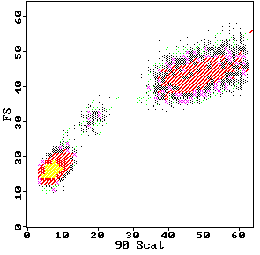
DCFH-DA DCFH DCF
2’,7’-dichlorofluorescin diacetate
O
O
CH3-C-O
O
O-C-CH3
Cl
Cl
2’,7’-dichlorofluorescin
H
COOH
HO
O
OH
Fluorescent
Cellular Esterases
Cl
Cl
H
COOH
2’,7’-dichlorofluorescein
Hydrolysis
HO
O
O
H₂O₂
Cl
Cl
Oxidation
H
COOH
DCFH-DA
Neutrophils
DCFH-DA
Monocytes
80
Control
PMA-stimulated PMN
DCFH
H O
60
2 2
Lymphocytes
counts
40
DCF
20
0
.1
1
10
100
1000
log FITC Fluorescence
Neutrophil Function, Oxidative Burst

Slide 78
Phagocytosis
Uptake of Fluorescent labeled particles
Determination of intracellular or extracellular state of particles
How the assay works:
Particles or cells are labeled with a fluorescent probe
The cells and particles are mixed so phagocytosis takes place
The cells are mixed with a fluorescent absorber to remove fluorescence from membrane bound particles
The remaining fluorescence
represents internal particles
FITC-Labeled Bacteria

Slide 79
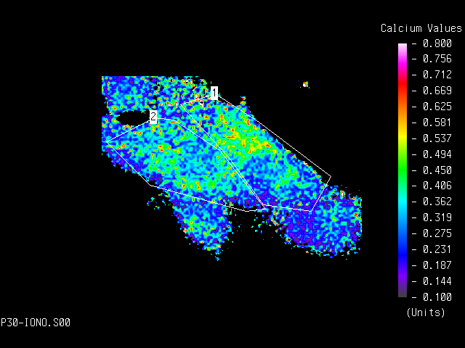
Ionic Flux Determinations
Calcium Indo-1
Intracellular pH BCECF
How the assay works:
Fluorescent probes such as Indo-1 are able to bind to calcium in a ratiometric manner
The emission wavelength decreases as the probe binds available calcium
0.8
0.7
0.6
0.5
0.4
Ratio: intensity of 460nm / 405nm signals
0.3
0.2
Stimulation
0.1
Time (seconds)
0
36
72
108
144
180
0
Time (Seconds)
0
50
100
150
200
Flow Cytometry Image Analysis

Slide 80
Research Applications
Phenotypic Analysis:
Immunophenotypic Analysis of Peripheral Blood Lymphocytes
Detection of Cytokine Receptors
Enumeration of CD34+ Hematopoietic Stem and Progenitor Cells
Measurement of CD40 Ligand Expression on Resting and In Vitro-Activated T Cells
Nucleic Acid Analysis:
Analysis of DNA Content and DNA Strand Breaks for Detection of Apoptotic Cells
DNA Content Measurement for DNA Ploidy and Cell Cycle Analysis
Analysis of DNA Content and BrdU Incorporation

Slide 81
Cell Function:
Oxidative Metabolism of Neutrophils
Measurement of Intracellular pH
Analysis of Mitochondrial Membrane Potential
Reporters of Gene Expression
Measurement of Intracellular Calcium Ions
Intracellular Cytokines
Microbiological Applications:
Antibiotic Susceptibility
Cell Cycle Analysis of Yeasts
DNA/RNA Analysis of Phytoplankton

Slide 82
Clinical Applications
Cancer therapy monitoring:
  DNA content of tumor cells is determined to assess the prognosis of cancer patients.
  DNA specific probes bind directly to the DNA to enable evaluation of normal and abnormal cells.
  The measurement of DNA content in cells was one of the earliest applications of flow cytometry.
  DNA specific dyes stain cells stoichiometricly, this means that the amount of stain is directly proportional to the amount of DNA.

Slide 83
Clinical Applications
Cell function analysis:
  Neutrophils (polymorphonuclear leukocytes) are a major contributor to the early inflammatory response and are a primary source of toxic oxygen metabolism.
  The function of these cells is important in combating bacterial infections.
  Flow cytometry has been used to study many disorders of the neutrophil.

Slide 84
Clinical Applications
Intracellular organelles can be stained with fluorescent labeled organelle-specific dyes and assessed for function as well.

Slide 85
Chromosome Karotyping
Flow cytogenetics is the classification and purification of chromosomes.
Human as well as other animal chromosomes have been isolated and genetic libraries constructed.
All chromosomes can be identified and sorted by using two fluorescent probes, Hoechst 33258 and Chromomycin A3.

Slide 86
Normal human
Normal hamster
Human X hamster
Normal mouse
J.W. Gray & L.S. Cram - MLM Chapt. 25

Slide 87
Fetal Cell Detection
Rare Cell Detection is relatively simple for an instrument that is capable of analyzing hundreds of thousands of cells in minutes.
Flow cytometry is useful in detecting bacteria in whole blood, identifying HIV-infected lymphocytes, revealing minimal residual disease in a malignant neoplasm and distinguishing fetal cells in maternal blood.
During the first trimester fetal cells cross the placenta and can be isolated from maternal blood. Fluorescence In-Situ Hybridization (FISH) uses chromosome-specific DNA probes that can identify any chromosomal abnormalities that may be present in the fetus. This procedure may replace amniocentesis as a noninvasive method of determining fetal status.

Slide 88
Clinical Applications
Platelets circulate in the peripheral blood in a quiescent state but initiate a cascade of events resulting in the formation of a fibrin clot when activated.
Many platelet defects responsible for bleeding disorders are diagnosed using flow cytometry to identify glycoprotein receptors.

Slide 89
Minimum Residual Disease
Patients that appear to be in complete remission can be found to have residual tumors cells that are too few in number to be counted by standard techniques.
Flow cytometry can detect these rare cells before they proliferate and cause the patient to relapse.

Slide 90
Flow Cytometric Crossmatch (FCXM)
Flow cytometry has become a valuable tool to assess potential solid organ allograph recipients.
It is now recognized as the laboratory procedure of choice. Circulating alloantibodies at levels too low to be detected by standard methods can be detected by a flow cytometric crossmatch (FCXM).
This means that transplants done based on a negative FCXM are more successful.

Slide 91
Transplantation
Patients with neoplastic disease require a minimum number of 2-5 X 106/kg recipient body weight of CD34+ cells for engraftment. Flow cytometry and the identification of the CD34 antigen on hematopietic progenitor cells has made this possible.
Patients with type 1 diabetes may have pancreatic islets transplanted thus eliminating the need for daily injections of insulin.

Slide 92
Leukemia and Lymphoma
Lymphomas are tumors of the immune system, primarily in the lymph nodes, spleen, and bone marrow.
Flow Cytometry has been used since the late 1970's to diagnose and classify human lymphomas. A standard panel of fluorescent labeled monoclonal antibodies is used for this purpose.

Slide 93
Commercial Applications
Biology and Cytometry of Sperm Sorting
Spermatozoal Differences
  Sex pre-selection is based on identifying differences between X- and Y-bearing sperm
  The X chromosome contains about 4% more DNA in cattle and horses than the Y chromosome.
  This difference in DNA content can be used to distinguish and select X from Y bearing sperm.

Slide 94
Emerging Applications
Microbiology
  Drug industry
  Molecular biology
  Food industry
  Dairy industry
  Water industry
  Defense industry

Slide 95
Fluorescent Dyes And Antibodies
Fluorochromes Are Molecules That Emit Fluorescence Upon Excitation With Light
  Ex. FITC (Fluorescein Isothiocyanate)
  PE (Phycoerythrin)
  PerCP (Peridinin Chlorophyll Protein)
  APC (Allophycocyanin)
Some Fluorochromes Are Proteins, Some Are Small Organic Compounds
  Ex. PE (Phycoerythrin)-Protein
  Ex. FITC (Fluorescein Isothiocyanate)

Slide 96
The FITC (fluorescein isothiocyanate) channel PMT will detect light emitted from FITC at a wavelength of approximately 519 nm.
The PE channel PMT will detect light emitted from PE (phycoerythrin) at 575 nm wavelength.
Each PMT will also detect any other fluorochromes emitting at a similar wavelength to the fluorochrome it is detecting.
Various filters are used in the flow cytometer to direct photons of the correct wavelength to each PMT

Slide 97
Principles Of Fluorescence
E= h f
υ = f λ

Slide 98
Excitation Spectra Of Fluorochromes

Slide 99
Analyzed Data

Slide 100
Antibody staining
Direct staining:
In direct immunofluorescence staining, cells are incubated with an antibody directly conjugated to a fluorochrome (e.g. FITC). This has the advantage of requiring only one antibody incubation step and eliminates the possibility of non-specific binding from a secondary antibody.
This approach is particularly useful for intracellular staining, where large antibody-fluorochrome complexes including secondary antibodies can become trapped causing non-specific binding, or fail to enter the cell preventing primary antibody detection.

Slide 101
Indirect staining:
In indirect staining, the primary antibody is not fluorochrome-labeled, but is detected by a fluorochrome-labeled secondary antibody. This second reagent may be an antibody with specificity for the first antibody. Alternatively, the avidin-biotin system can be used, whereby an antibody is conjugated to biotin and detected with fluorochrome-labeled avidin.
With the wide range of conjugated antibodies now available, this method means that unconjugated primary antibodies raised against many different targets can be used in conjunction with a labeled secondary antibody for FACS analysis. This widens the choice of target proteins for the researcher.

Slide 102
Intracellular staining:
Staining of intracellular antigens for flow cytometry protocols depends on various fixation and permeabilization methods to allow access of antibodies to internal cellular proteins. A successful staining procedure in all cases is dependent on optimization of experimental conditions through titering of antibodies, use of appropriate controls to set up the flow cytometer correctly and optimized fixation and permeabilization procedures.

Slide 103
Detection of secreted proteins:
Detection of secreted proteins is difficult as the protein will be released from the cell before detection, or may degrade rapidly. A Golgi block such as Brefeldin A can be used to inhibit secretion of expressed proteins, retaining them in the Golgi apparatus. The intracellular staining method can then be used for detection of the target protein.

Slide 104
Selecting a fluorochrome conjugate
The ability of a given antibody to resolve a positive signal from a negative signal often depends on which fluorochrome conjugate is used.
A general guideline for the relative intensities of the various fluorochromes is, from brightest to dimmest, PE, PE-Cy 7, PE-Cy5, APC, APC-Cy7, Alexa Fluor 647®, Alexa Fluor 700®, FITC, Pacific Blue, Alexa Fluor 488®. This is a general pattern; some differences in the relative intensities are seen for individual antibodies.
A highly expressed antigen will usually be detected and resolved from the negative control with almost any fluorochrome. An antigen expressed at lower density might require the higher signal to background ratio provided by a brighter PE or APC conjugate to separate the positive cells adequately from the unstained cells.
The relative fluorochrome intensity depends on the instrument. This is because of differences in the laser and filter combinations used on the different instruments. Be sure to use the appropriate FACS instrument.

Slide 105
FITC Annexin V/Dead Cell Apoptosis
Apoptosis
Regulated process of cell death as normal part of development
Regulated apoptosis is implicated in disease such as Alzheimer and cancer
Characteristic morphological and biochemical changes
Compaction and fragmentation of the nuclear chromatin, shrinkage of the cytoplasm, loss of membrane asymmetry

Slide 106
In normal cells phosphatidylserine (PS) is located on the cytoplasmic surface of the cell membrane.
In apoptotic cells PS is translocated from the inner to the outer leaflet of the plasma membrane
The human anticoagulant, annexin V is 35-36 KDa Ca 2+ - dependent phospholipid –binding protein that has a high affinity for PS
Annexin V labeled with a fluorophore ( fluorescein, FITC)
PI is impermeant to live cells and apoptotic cells

Slide 107
Experimental protocol
Harvest the cells
Washing with cold phosphate- buffered saline
Prepare 1X annexin V- binding buffer
suspend the cells in binding buffer in 1* 10 6 cell dilution
Add 5 µl FITC and PI
Incubate for 15 min
Add 400 µl annexin V – binding buffer
Keep on ice
Measuring the fluorescence emission at 530nm

